Slide 1

Infosys Springboard Virtual Internship 6.0
BIKE SHARING DEMAND PREDICTION
Leveraging Machine Learning for Smarter Urban Mobility
Guide: Vishwanth Prayaga, Data Scientist at Infosys
Presenter: Preetham N

Slide 2

The Challenge: Dynamic Urban Mobility
Problem: Traditional transportation struggles with traffic congestion, pollution, and rising fuel costs.
Solution: Bike-sharing offers an eco-friendly, flexible, and cost-effective alternative for short trips.
The Key Challenge: Demand is highly dynamic and influenced by weather, season, and time (weekday/weekend).
Motivation: Effective operation requires anticipating user demand. Under/overestimation leads to station shortages or too many idle bikes, causing user inconvenience and inefficient operations.
Goal: Build a robust, data-driven prediction model to optimize fleet distribution and improve service reliability.

Slide 3

Project Objective: From Data to Actionable Insights
Goal: Develop a reliable machine learning system to predict daily bike-sharing demand using historical usage, weather, and temporal features.
Specific Objectives:
Compare Models: Benchmark multiple regression models (Linear, Ridge, Lasso, Random Forest, etc.) to find the best fit.
Identify Key Predictors: Analyze the influence of temperature, season, humidity, and holiday status on demand.
Build an End-to-End Pipeline: Cover data preprocessing,
feature engineering, model training, and saving artifacts.
Deploy: Create a Streamlit web application for real-time
demand prediction.
Visual Suggestion: A simple flow chart showing the pipeline:
Data → Preprocessing -> Model Training -> Prediction -> Streamlit App.

Slide 4


Dataset & Key Features
Dataset: UCI Bike Sharing Dataset (2 years of rental activity in Washington D.C., 2018–2019).
Target Variable: cnt (Total count of rented bikes - our prediction target).
Feature Categories:
Temporal/Calendar: season, yr (2011/2012), mnth, weekday, holiday, workingday.
Weather/Environmental: weathersit (Categorical: Clear-> Severe), temp (normalized), hum (normalized), windspeed (normalized).
Data Preparation (Preprocessing):
Encoding: Converting categorical features (like season, weekday) to numeric format (One-Hot Encoding)
Scaling: Standardizing numerical features (temp, hum, windspeed) using StandardScaler to prevent bias.
Splitting: Separating into 80% Training and 20% Testing sets.

Slide 5
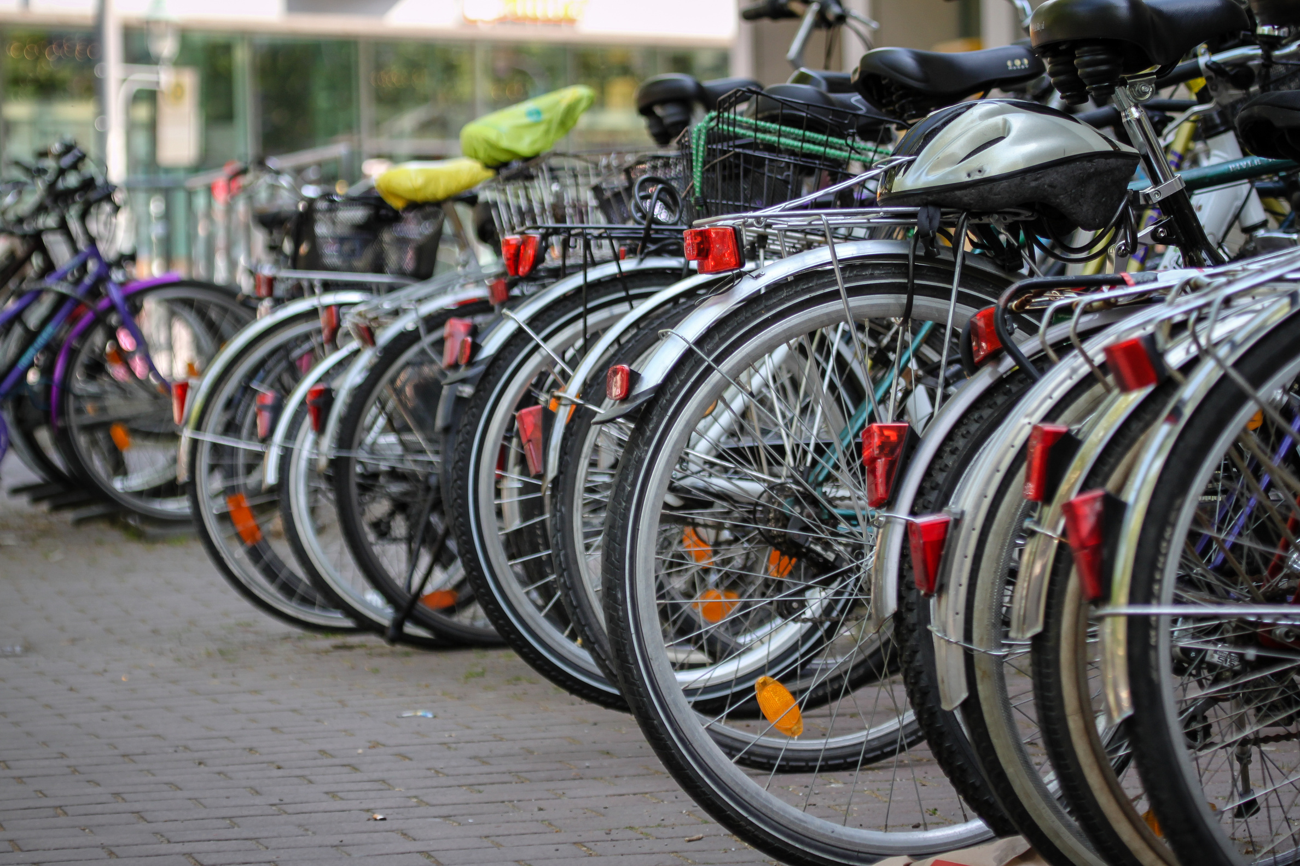
Demand Trends: What Drives Rentals?
Key Findings (Preprocessing Results):
Seasonality: Highest demand in Fall (Season 3), followed closely by Summer. Lowest in Spring.
Annual Growth: Demand increased from Year 0 (2018) to Year 1 (2019)
Weather Impact: Demand significantly decreases as weather worsens (Highest in Category 1: Clear)
Weekly Trend: Peak demand occurs on Friday. The difference between working days and non-working days is slight, showing consistent weekly usage.

Slide 6

Regression Models: Linear vs. Ensemble
Models Evaluated:
Linear Models: Linear Regression, Lasso (L1 Regularization for feature selection), Ridge (L2 Regularization for overfitting).
Tree-Based Models: Decision Tree Regressor, Random Forest Regressor, Gradient Boosting Regressor.
Performance Metric: RMSE (Root Mean Squared Error) and R² Score (Coefficient of Determination).
Training Results Summary:
Linear Models: R² approx 0.846, RMSE approx726 (Limited by linear assumption).
Decision Tree: R² approx 0.864, RMSE approx 681(Better, captured non-linearity).
Random Forest (The Winner): R² approx 0.9094, RMSE approx 556.99.

Slide 7


Final Selection: Why Random Forest Wins
Performance: Achieved the highest R² (0.9094) and lowest RMSE (556.99) on the training set.
Key Advantage: Random Forest is an ensemble method (multiple decision trees) that is robust to noise and excels at capturing complex, non-linear interactions between features (like how temperature, season, and working day interact).
Conclusion: Ensemble models are most suitable for this type of complex prediction problem.
Testing Phase: The model performed consistently on unseen data, confirming its strong generalization capability.

Slide 8

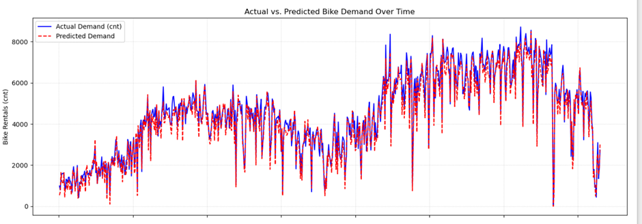
Testing Phase: Validating Generalization
Procedure: Models were validated on the 20% unseen test data to ensure they learned relationships, not just memorized the training patterns
Consistency is Key: The test data underwent the exact same preprocessing (One-Hot Encoding, Feature Scaling with the saved scaler) to prevent input mismatch.
Residual Plot Insight: The plot shows the difference (Actual - Predicted) scattered around zero, indicating the model's errors are generally small and unbiased across the test period.

Slide 9
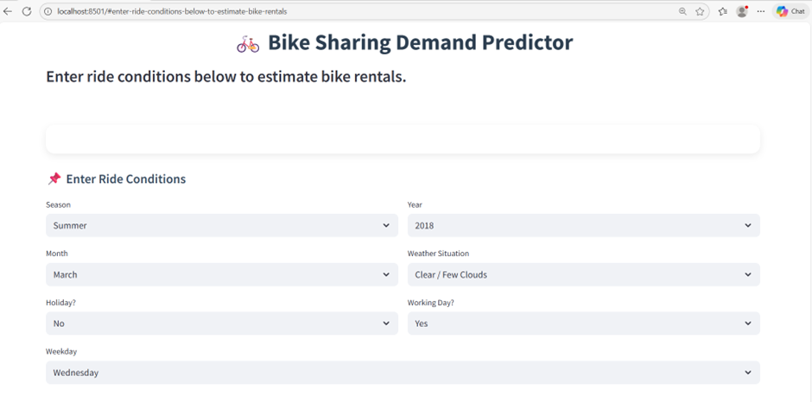
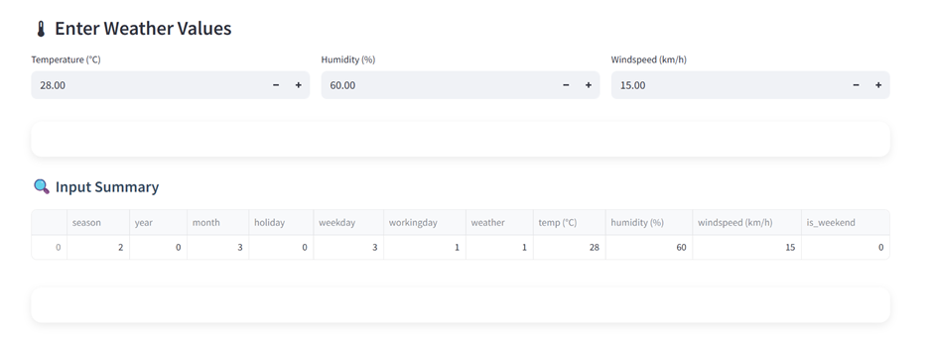
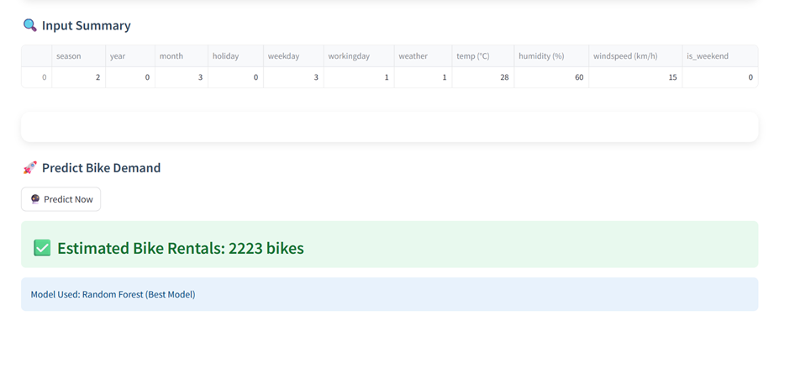
Real-World Application: The Streamlit Interface
Technology: Built using Streamlit, a Python library for fast web app deployment.
Functionality:
Allows users to input ride conditions (Season, Month, Weather Situation, Temperature, Humidity, etc.).
Uses the saved best model (Random Forest) to generate an estimated demand.
Output: Provides a clear, estimated count of bike rentals (e.g., "Estimated Bike Rentals: 2223 bikes")

Slide 10


Conclusion
The Random Forest Regressor is the most effective and reliable model for bike-sharing demand prediction, achieving superior accuracy over linear and single-tree models.
Actionable Insights: This system provides a strong foundation for:
Fleet Rebalancing: Ensuring bikes are where demand is predicted to be highest.
Resource Planning: Optimizing staffing and maintenance schedules.
Strategic Operation: Supporting sustainable and intelligent urban mobility systems.

Slide 11

THANK YOU

